Slide 1
Natural Language Processing in Python
Aunchana PImpisal
11-12 Mar 2023

Slide 2
OUTLINE
Intro Natural Language Processing
Regular expression
Text classification
Sentiment analysis
Web scraping
Pythainlp library
Part of Speech(POS)& Named Entity Recognition(NER)
Word2vec

Slide 3
Text Classification

Slide 4


TEXT CLASSIFICATION
sport
Preprocessing
Train Datset
80 % of Total
Train Dataset : TFIDF
Train model
Machine Learning
business
MUTIMONOMIALNB
politics
tech
Predict
Test Dataset
20 % of Total
Test Dataset :TFIDF
entertainment
sport
Confusion matrix
business
Result
politics
BBC News
tech
entertainment

Slide 5
TOKENIZATION
Tokenization is a process separating text or content into token.
Tokenization have 3 types are
Example : . I love Natural Language Processing.
Word Tokenization: ['I', 'love', 'Natural', 'Language', 'Processing', '.’]
Character Tokenization : ['I',' ','l','o','v','e',' ','N','a','t','u','r','a','l',' ','L','a','n','g','u','a','g','e',' ',' ','P','r','o','c','e','s','s','i','n','g','. ‘]
Subword (n-gram characters) Tokenization : ['I love', 'love Natural', 'Natural Language', 'Language Processing', 'Processing .']

Slide 6
STEMMING
Stemming is a process to remove suffixes from words referring heuristic process.
Example of stemming:
university -> unives
cats -> cat
Company -> compani
Stemming may not always produce the correct root form of a word.
Stemming algorithms such as PorterStemmer ,SnowballStemmer etc.

Slide 7
LEMMATIZATION
Lemmatization is the process of grouping the inflected forms of a word refers to the morphological analysis of words and return in dictionary form
Examples of lemmatization:
rocks : rock
corpora : corpus
better : good
Different Lemmatization&Stemming
Stemming refers to a heuristic process changing suffix.
Lemmatization refers to structure of a vocabulary and morphological analysis of words
https://www.geeksforgeeks.org/python-lemmatization-with-nltk/

Slide 8
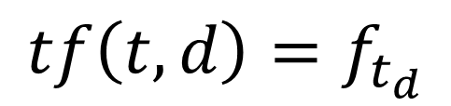
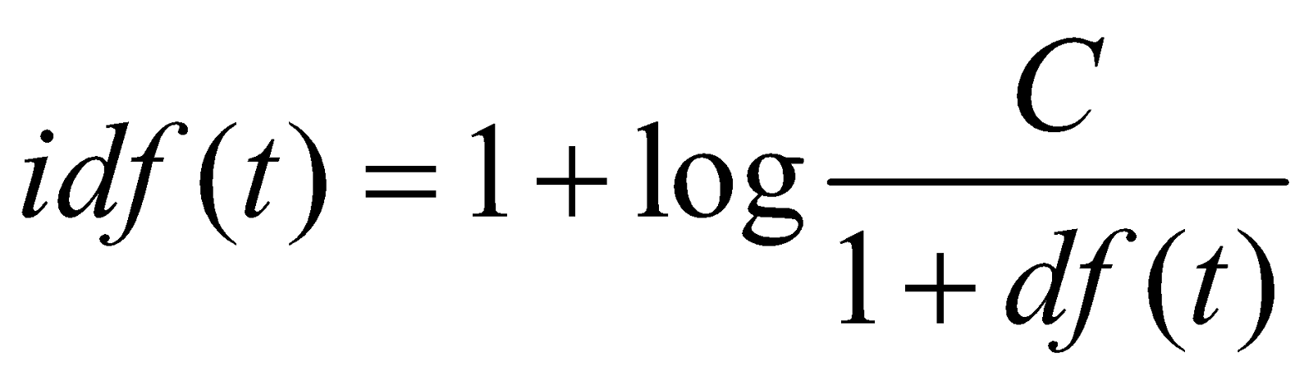
TFIDF
TF-IDF stands for Term Frequency-Inverse Document Frequency.
Term Frequency (TF) is the frequency of the word t within the document d.
Inverse Document Frequency is the frequency of document contained word t and C is the total of documents.

Slide 9
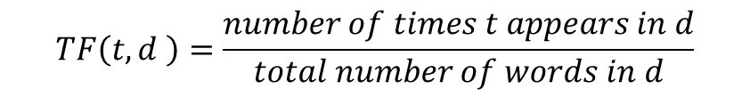
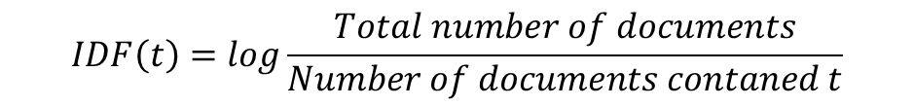
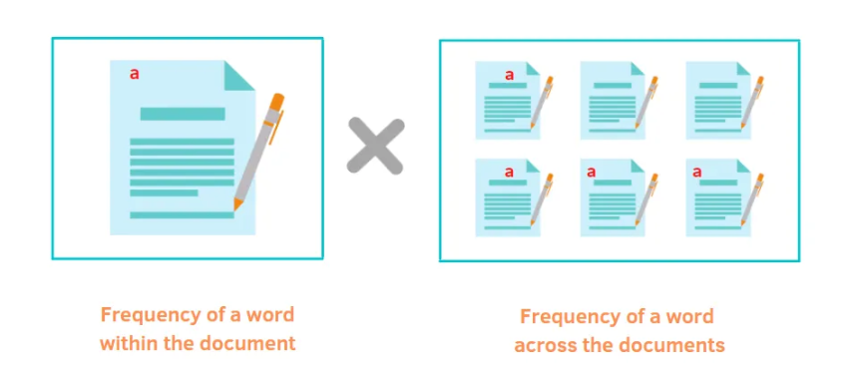
TFIDF
https://betterprogramming.pub/a-friendly-guide-to-nlp-tf-idf-with-python-example-5fcb26286a33

Slide 10
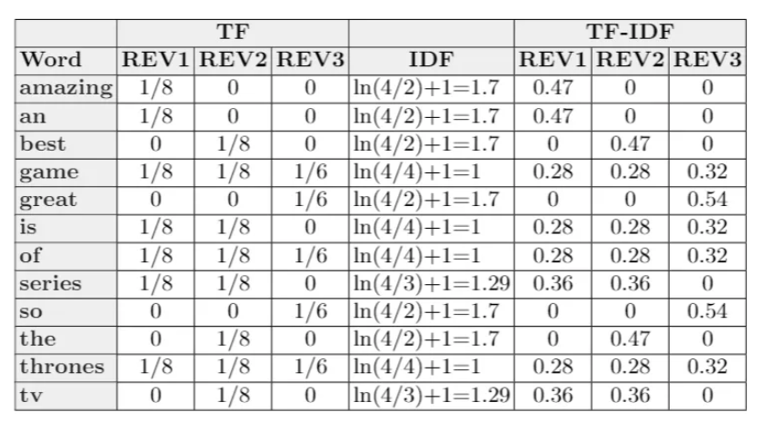
TFIDF
Review 1: Game of Thrones is an amazing TV series!
Review 2: Game of Thrones is the best TV series!
Review 3: Game of Thrones is so great.
https://betterprogramming.pub/a-friendly-guide-to-nlp-tf-idf-with-python-example-5fcb26286a33

Slide 11
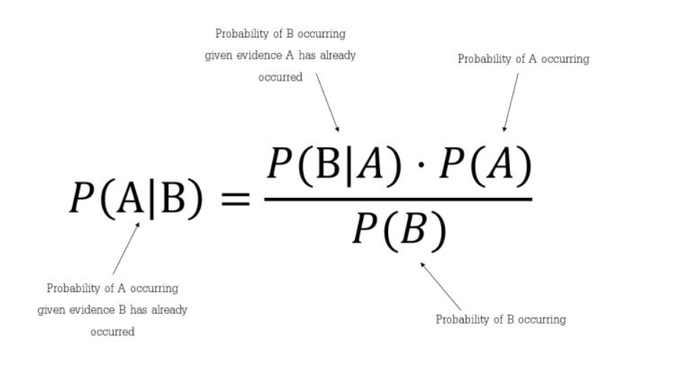
MODEL:MUTIMONOMIALNB
MultinomialNB implements the naive Bayes algorithm for multinomially distributed data
The multinomial Naive Bayes classifier is suitable for classification with discrete features (e.g., word counts for text classification).

Slide 12
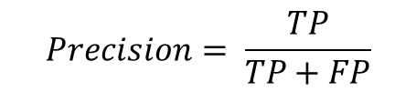
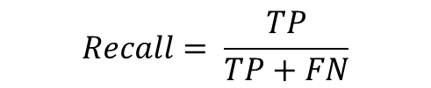
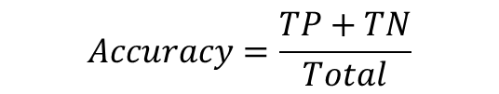

CONFUSION MATRIX
Actual
 | 1 | 0
1 | TP | FP
0 | FN | TN
Predicted

Slide 13
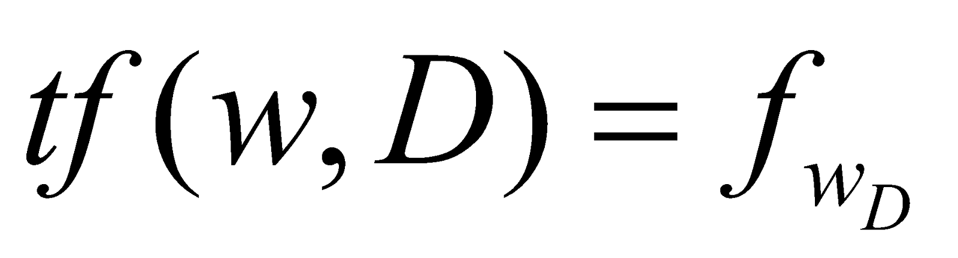
REFERENCE
https://scikit-learn.org/stable/modules/feature_extraction.html#text-feature-extraction
https://gitlab.com/softnixresearch/tf-idf/tree/master/
https://lukkiddd.com/tf-idf-%E0%B8%84%E0%B8%B3%E0%B9%84%E0%B8%AB%E0%B8%99%E0%B8%AA%E0%B8%B3%E0%B8%84%E0%B8%B1%E0%B8%8D%E0%B8%99%E0%B8%B0-dd1e1568312e
https://betterprogramming.pub/a-friendly-guide-to-nlp-tf-idf-with-python-example-5fcb26286a33
https://nlp.stanford.edu/IR-book/html/htmledition/stemming-and-lemmatization-1.html

Slide 14
REFERENCE
https://www.techtarget.com/searchenterpriseai/definition/stemming#:~:text=Stemming%20is%20the%20process%20of,natural%20language%20processing%20(NLP).
https://towardsdatascience.com/stemming-vs-lemmatization-in-nlp-dea008600a0
https://machinelearningknowledge.ai/nltk-tokenizer-tutorial-with-word_tokenize-sent_tokenize-whitespacetokenizer-wordpuncttokenizer/
https://www.analyticsvidhya.com/blog/2020/05/what-is-tokenization-nlp/
https://www.softnix.co.th/2019/05/28/tf-idf-%E0%B8%97%E0%B8%B3%E0%B8%87%E0%B8%B2%E0%B8%99%E0%B8%A2%E0%B8%B1%E0%B8%87%E0%B9%84%E0%B8%87/

Slide 15
REFERENCE
https://medium.com/analytics-vidhya/confusion-matrix-in-machine-learning-91b6e2b3f9af
https://scikit-learn.org/stable/modules/naive_bayes.html#multinomial-naive-bayes
https://towardsdatascience.com/understanding-confusion-matrix-a9ad42dcfd62
https://www.upgrad.com/blog/multinomial-naive-bayes-explained/

Slide 16
Web Scraping

Slide 17







WEB SCRAPING
Web scraping is the process of collecting data from the structure of website.
Website
HTML Structure
Python Script
File

Slide 18
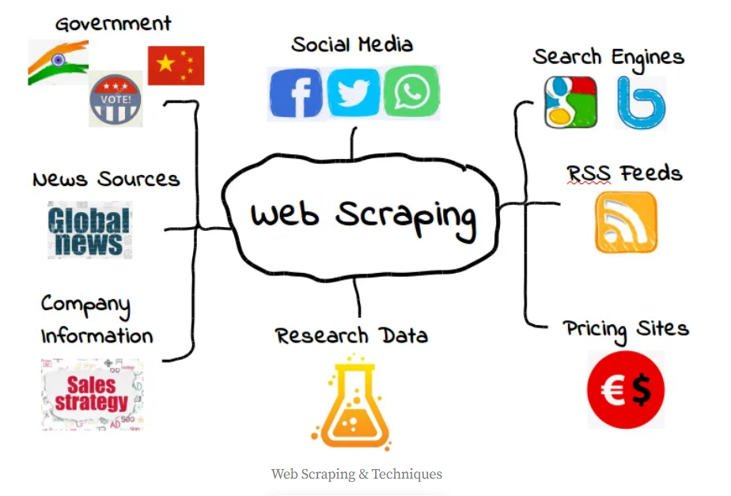
WEB SCRAPING
https://roboticsandautomationnews.com/2020/04/06/essential-legal-issues-associated-with-web-scraping/31501/

Slide 19
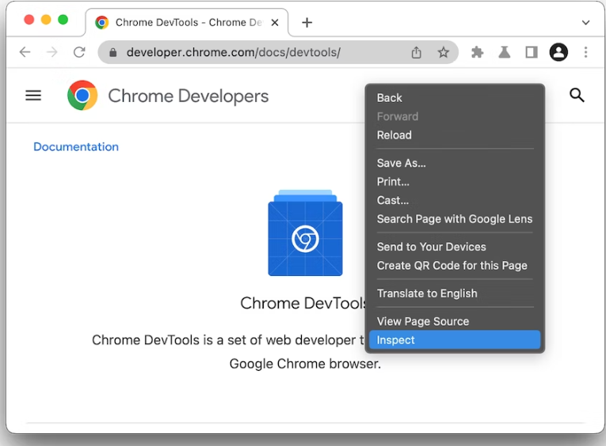
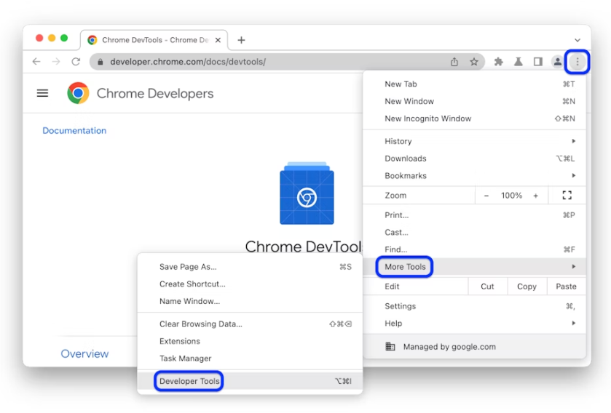
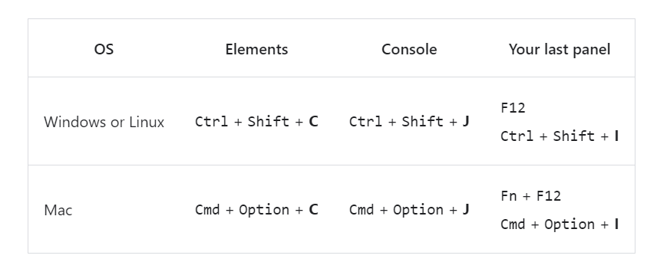
TOOL FOR HTML STRUCTURE
https://www.sanook.com/money/896451/
Open Chrome DevTools
https://developer.chrome.com/docs/devtools/open/

Slide 20
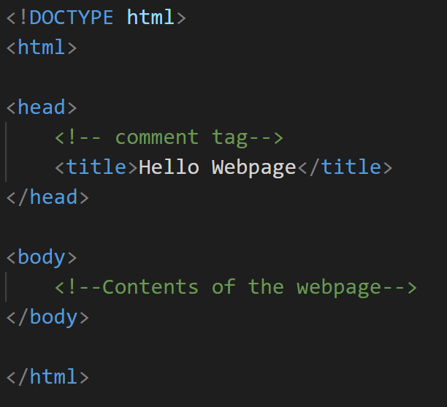
BASIC HTML
<html> : Every HTML code must be enclosed between basic HTML tags
<head>: The head contains all the header information of the web page or documents.
<title>: This is header information.
<body>: The body tag contains the actual body of the page which will be visible to all the users
https://www.geeksforgeeks.org/html-basics/

Slide 21
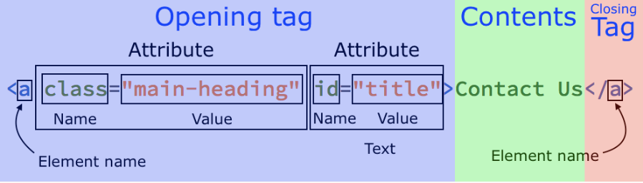
HTML ELEMENT SYNTAX
https://codetheweb.blog/html-syntax/

Slide 22
HTML TAGS
Tags | Syntax | Description
anchor | <a herf=” “> …</a> | To create a hyperlink on the webpage.
div | <div>Content</div> | To make divisions of content in the web page (text, images, header, footer, navigation bar, etc).
heading | <h1>Heading1</h1> | To define the headings of a page. These 6 heading elements are h1, h2, h3, h4, h5, and h6; with h1 being the highest level and h6 being the least
paragraphs | <p> Content </p> | To defines a paragraph.
https://www.geeksforgeeks.org/html-tags-a-to-z-list/?ref=lbp

Slide 23
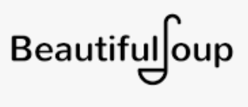


PYTHON LIBRARY FOR WEB SCRAPING
Library | Detail | Website
Beautifulsoup | pulling data out of HTML and XML files Very easy to use
Selenium | based automation testing framework Uses the WebDriver protocol to control web browsers like Chrome, Firefox, or Safari
Scrapy | data mining Data monitoring automated testing | https://scrapy.org/
https://www.crummy.com/software/BeautifulSoup/bs4/doc/
https://selenium-python.readthedocs.io/

Slide 24
REFERENCE
https://thestartupcto.org/web-scraping-techniques-5030fbf1fba
https://jovian.com/aakashns/python-web-scraping-project-guide
https://www.crummy.com/software/BeautifulSoup/bs4/doc/
https://selenium-python.readthedocs.io/
https://scrapy.org/
https://www.geeksforgeeks.org/html-tags-a-to-z-list/?ref=lbp
https://codetheweb.blog/html-syntax/

Slide 25
Word2Vec

Slide 26
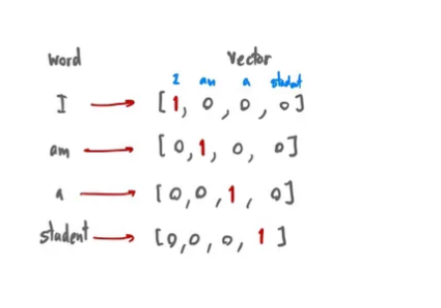
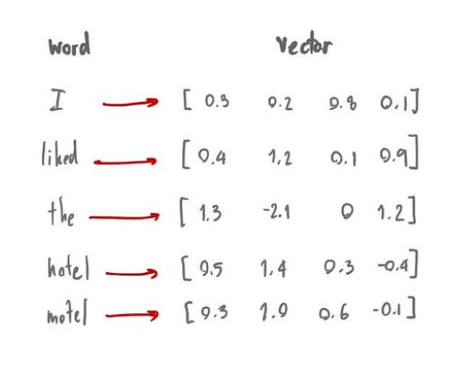
WORD EMBEDDING
Words transforms into a numerical representation of the word in term of vector.
Characteristics includes the semantic relationship of the word, definitions, context
One hot encoding
Word Embedding
https://lukkiddd.com/word-embedding-%E0%B9%81%E0%B8%A5%E0%B8%B0-word2vec-%E0%B8%84%E0%B8%B7%E0%B8%AD%E0%B8%AD%E0%B8%B0%E0%B9%84%E0%B8%A3-e60bdf6d78d3

Slide 27
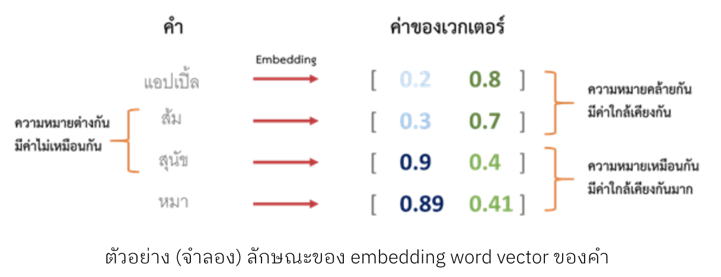
Word Embedding
Word2Vec Word Embedding, Part I - Big Data Thailand

Slide 28
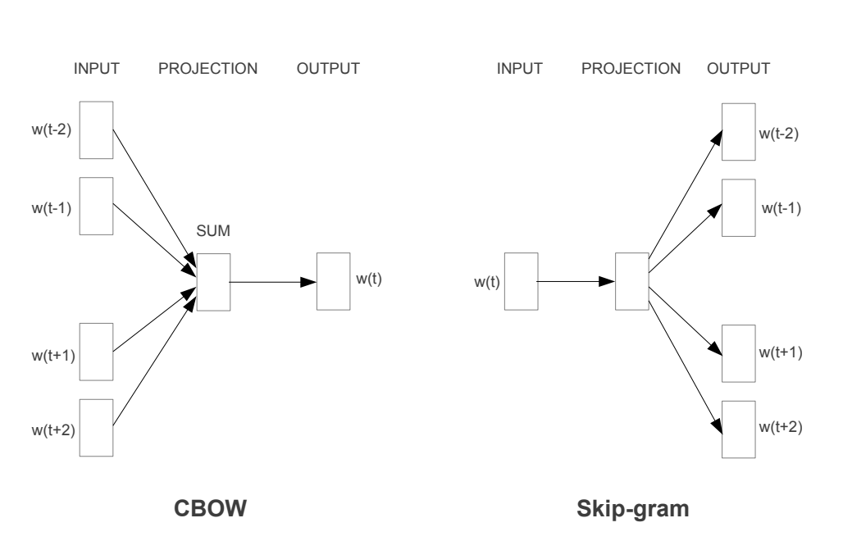
CBOW (CONTINUOUS BAG OF WORDS)
CBOW predicts the current word given context words within a specific window.
The input layer contains the context words and the output layer contains the current word.
The hidden layer contains the number of dimensions that represent the current word present at the output layer.
The CBOW architecture predicts the current word based on the context.

Slide 29
SKIP GRAM
Skip gram predicts the surrounding context words within specific window given current word.
The input layer contains the current word and the output layer contains the context words.
The hidden layer contains the number of dimensions that represent current word present at the input layer.
The Skip-gram predicts surrounding words given the current word

Slide 30

GENSIM
Gensim is an open-source library for unsupervised topic modeling, document indexing, retrieval by similarity, and other natural language processing functionalities, using modern statistical machine learning.
The word2vec algorithms include skip-gram and CBOW models, using either hierarchical softmax or negative sampling:
https://radimrehurek.com/gensim/intro.html#:~:text=Gensim%20is%20a%20free%20open,using%20unsupervised%20machine%20learning%20algorithms.

Slide 31
Q&A

